Slide 1
The bronchial epithelial immune response to multiple triggers: the key role of epithelial cytokines
Content developed in collaboration with Sebastian Johnston
(Professor of Respiratory Medicine and Allergy, Imperial College London, UK),​ and Asger Sverrild (Clinical Associate Professor, Bispebjerg Hospital, Copenhagen, Denmark)

Slide 2
Up to 65% of asthma exacerbations are associated with viral infections
Virus
Cases
Total
Proportion [95% CI]
hMPV
RSV
IfV
hPIV
RV
157
479
200
121
1341
1732
2036
2109
2109
2129
5.02 [2.43, 8.33]
16.23 [9.84, 23.74]
7.93 [4.33, 12.36]
5.81 [3.59, 8.43]
68.53 [58.50, 77.79]
Children
hMPV
RSV
IfV
hPIV
RV
26
29
73
52
213
280
405
364
355
422
8.54 [4.26, 13.93]
5.69 [2.17, 10.35]
18.75 [12.42, 25.92]
13.00 [2.14, 29.51]
45.60 [27.10, 64.72]
Adults
0.00
10.00
20.00
30.00
40.00
50.00
60.00
70.00
80.00
Proportion (%)
A meta-analysis and systematic literature search was conducted with the aim of quantifying the viral prevalence of common respiratory viruses (hMpV, RSV, IfV, hPIV, RV) in asthmatic patients with exacerbations, and identifying influencing factors. 42 studies were deemed eligible for meta-analysis, 14 studies focused on viral infections in adults, and 28 focused on children. Random-effect analysis was performed to quantify prevalence of viruses.
CI, confidence interval; hMPV, human metapneumovirus; hPIV, human parainfluenza virus; IfV, influenza virus; RSV, respiratory syncytial virus; RV, rhinovirus
Feddema JJ, Claassen E. Respir Med 2020;173:106020

Slide 3

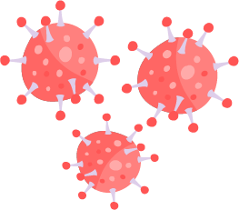

Impact of respiratory viruses on airway epithelium in asthma
Healthy
Asthma
Mucus
Bacteria
Cilial disorientation
and loss of cilia
Virus
Epithelium
Tight
junctions
Small gaps in the
tight junctions
Increased
mucin content
Increased barrier permeability
Junction dysfunction^{1,2}
Randomly tangled
coils of mucins
Impaired host resistance
Decreased IFN production^{3,4}
Increased viral replication⁴
Dysregulated host tolerance
Increased production of TSLP,
IL-33 and other cytokines^{5,6}
Densely packed
tethered mucins /
glycostructures
Figure adapted from Frey A, et al. Front Immunol 2020;11:761 licensed under CC-BY 4.0 from: https://creativecommons.org/licenses/by/4.0/ (Accessed 15 May 2023
IFN, interferon; IL-33, interleukin 33; TSLP, thymic stromal lymphopoietin
1. Looi K, et al. Exp Lung Res 2016;42:380–395; 2. Saatian B, et al. Tissue Barriers 2013;1:e24333; 3. Contoli M, et al. Nat Med 2006;12:1023–1026; 4. Wark PA, et al. J Exp Med 2005;201:937–947;
5. Uller L, et al. Thorax 2010;65:626–632; 6. Porsbjerg C, et al. Eur Respir J 2022;60:2102333

Slide 4
Impaired innate antiviral responses in BECs in asthma increase the risk of exacerbation
The induction of IFN-β and IFN-λ by rhinovirus (RV) and other viruses is deficient and delayed in BECs from adult and paediatric patients with asthma^{1–3}
  Deficiency is related to markers of underlying asthma severity^{1,3}
  IFN-λ deficiency is related to asthma exacerbation severity³
Low IFN response and high T2 inflammation are strong risk factors for asthma exacerbations⁴
BEC, bronchial epithelial cell; IFN-β, interferon beta; IFN-λ, interferon lambda; RV, rhinovirus; T2, type 2
1. Wark PA, et al. J Exp Med 2005;201:937–947; 2. Edwards MR, et al. Mucosal Immunol 2013;6:797–806; 3. Contoli M, et al. Nat Med 2006;12:1023–1026; 4. Altman MC, et al. Nat Immunol 2019;20:637–651

Slide 5
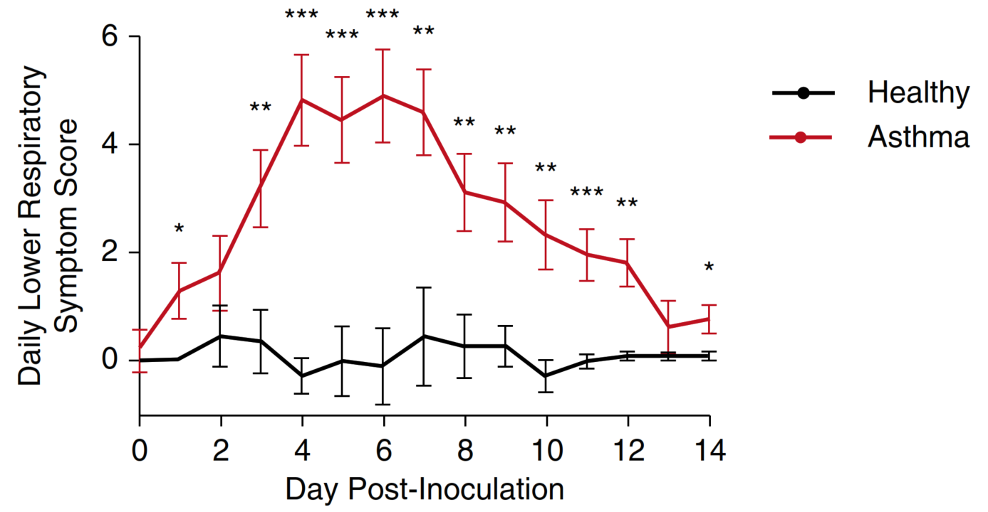
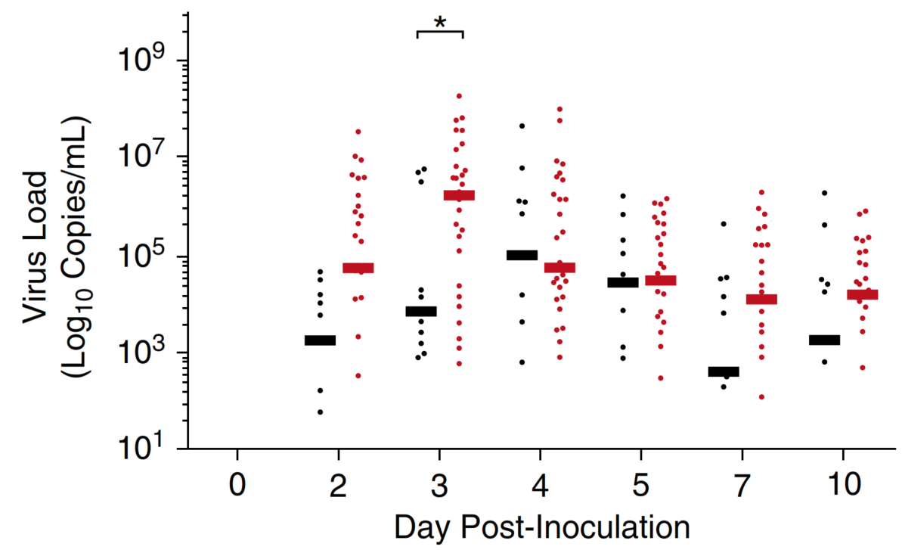
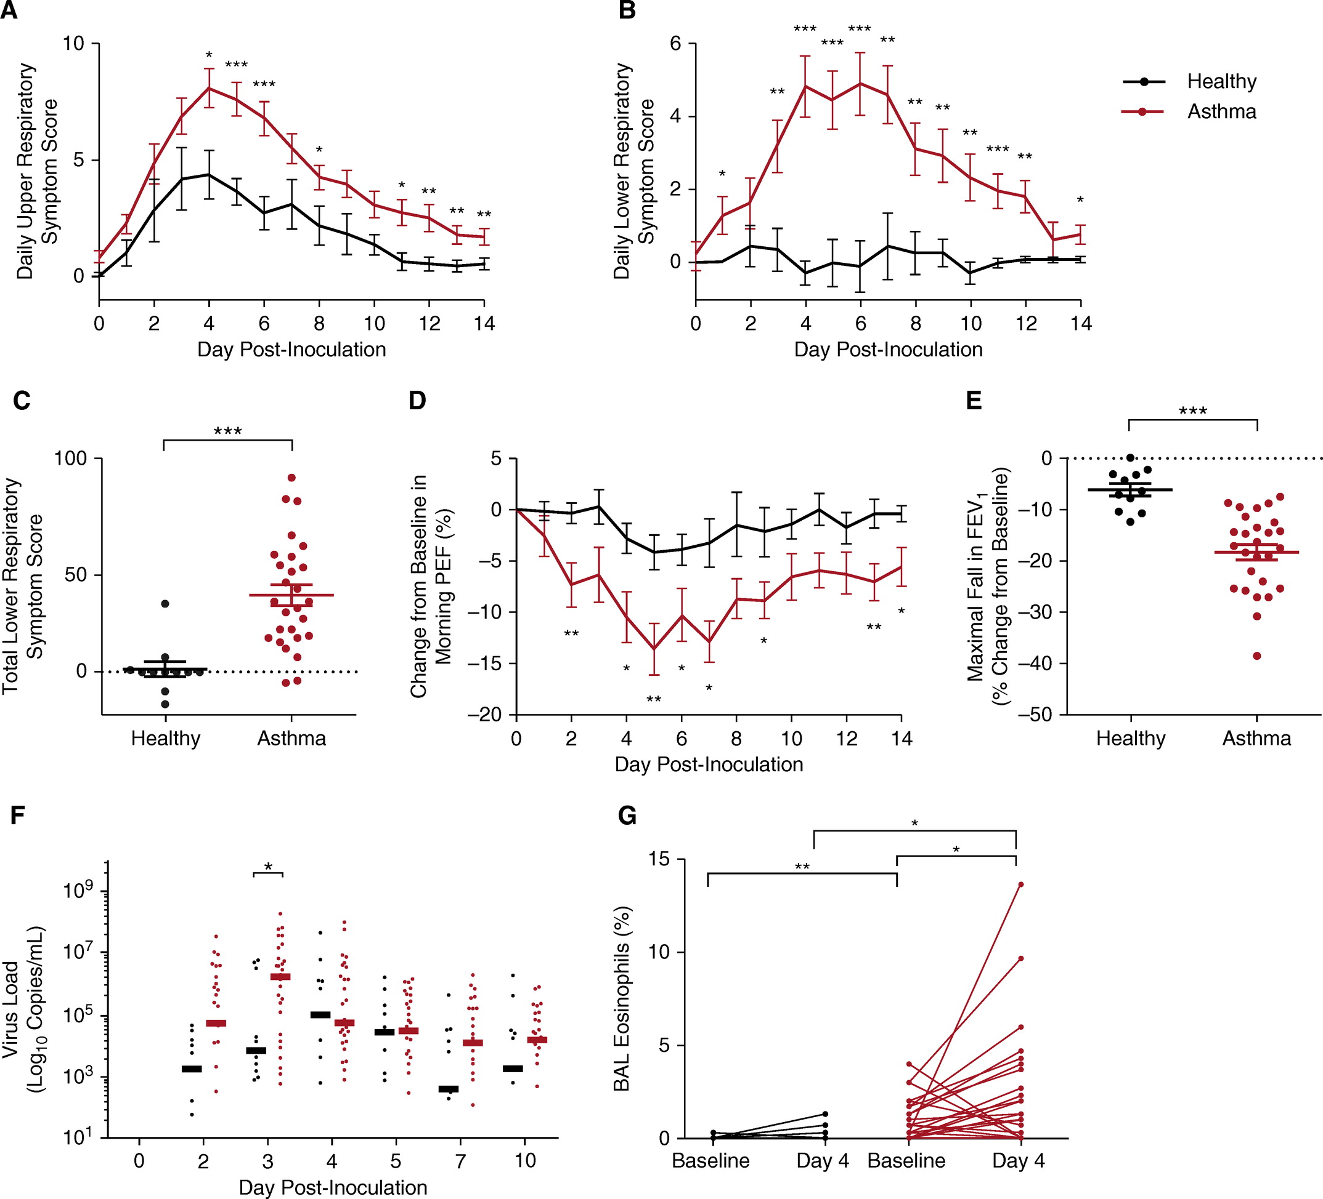
Increased viral load in asthma correlates with exacerbated lower respiratory symptoms
Increased viral load at Day 3 correlates with peak in
lower respiratory symptoms score
Healthy and asthmatic individuals were inoculated with RV-16 on Day 0
In patients with asthma:
  Nasal lavage viral load significantly increased on Day 3
  Earlier peak viral load and slower virus clearance
  was observed
  Lower respiratory symptoms were observed
†
#
*P<0.05, **P<0.01, ***P<0.001, †Data are mean ±SEM, #Bars represent median values
RV, rhinovirus
Jackson DJ, et al. Am J Res Crit Care Med 2014;190:1373–1382

Slide 6
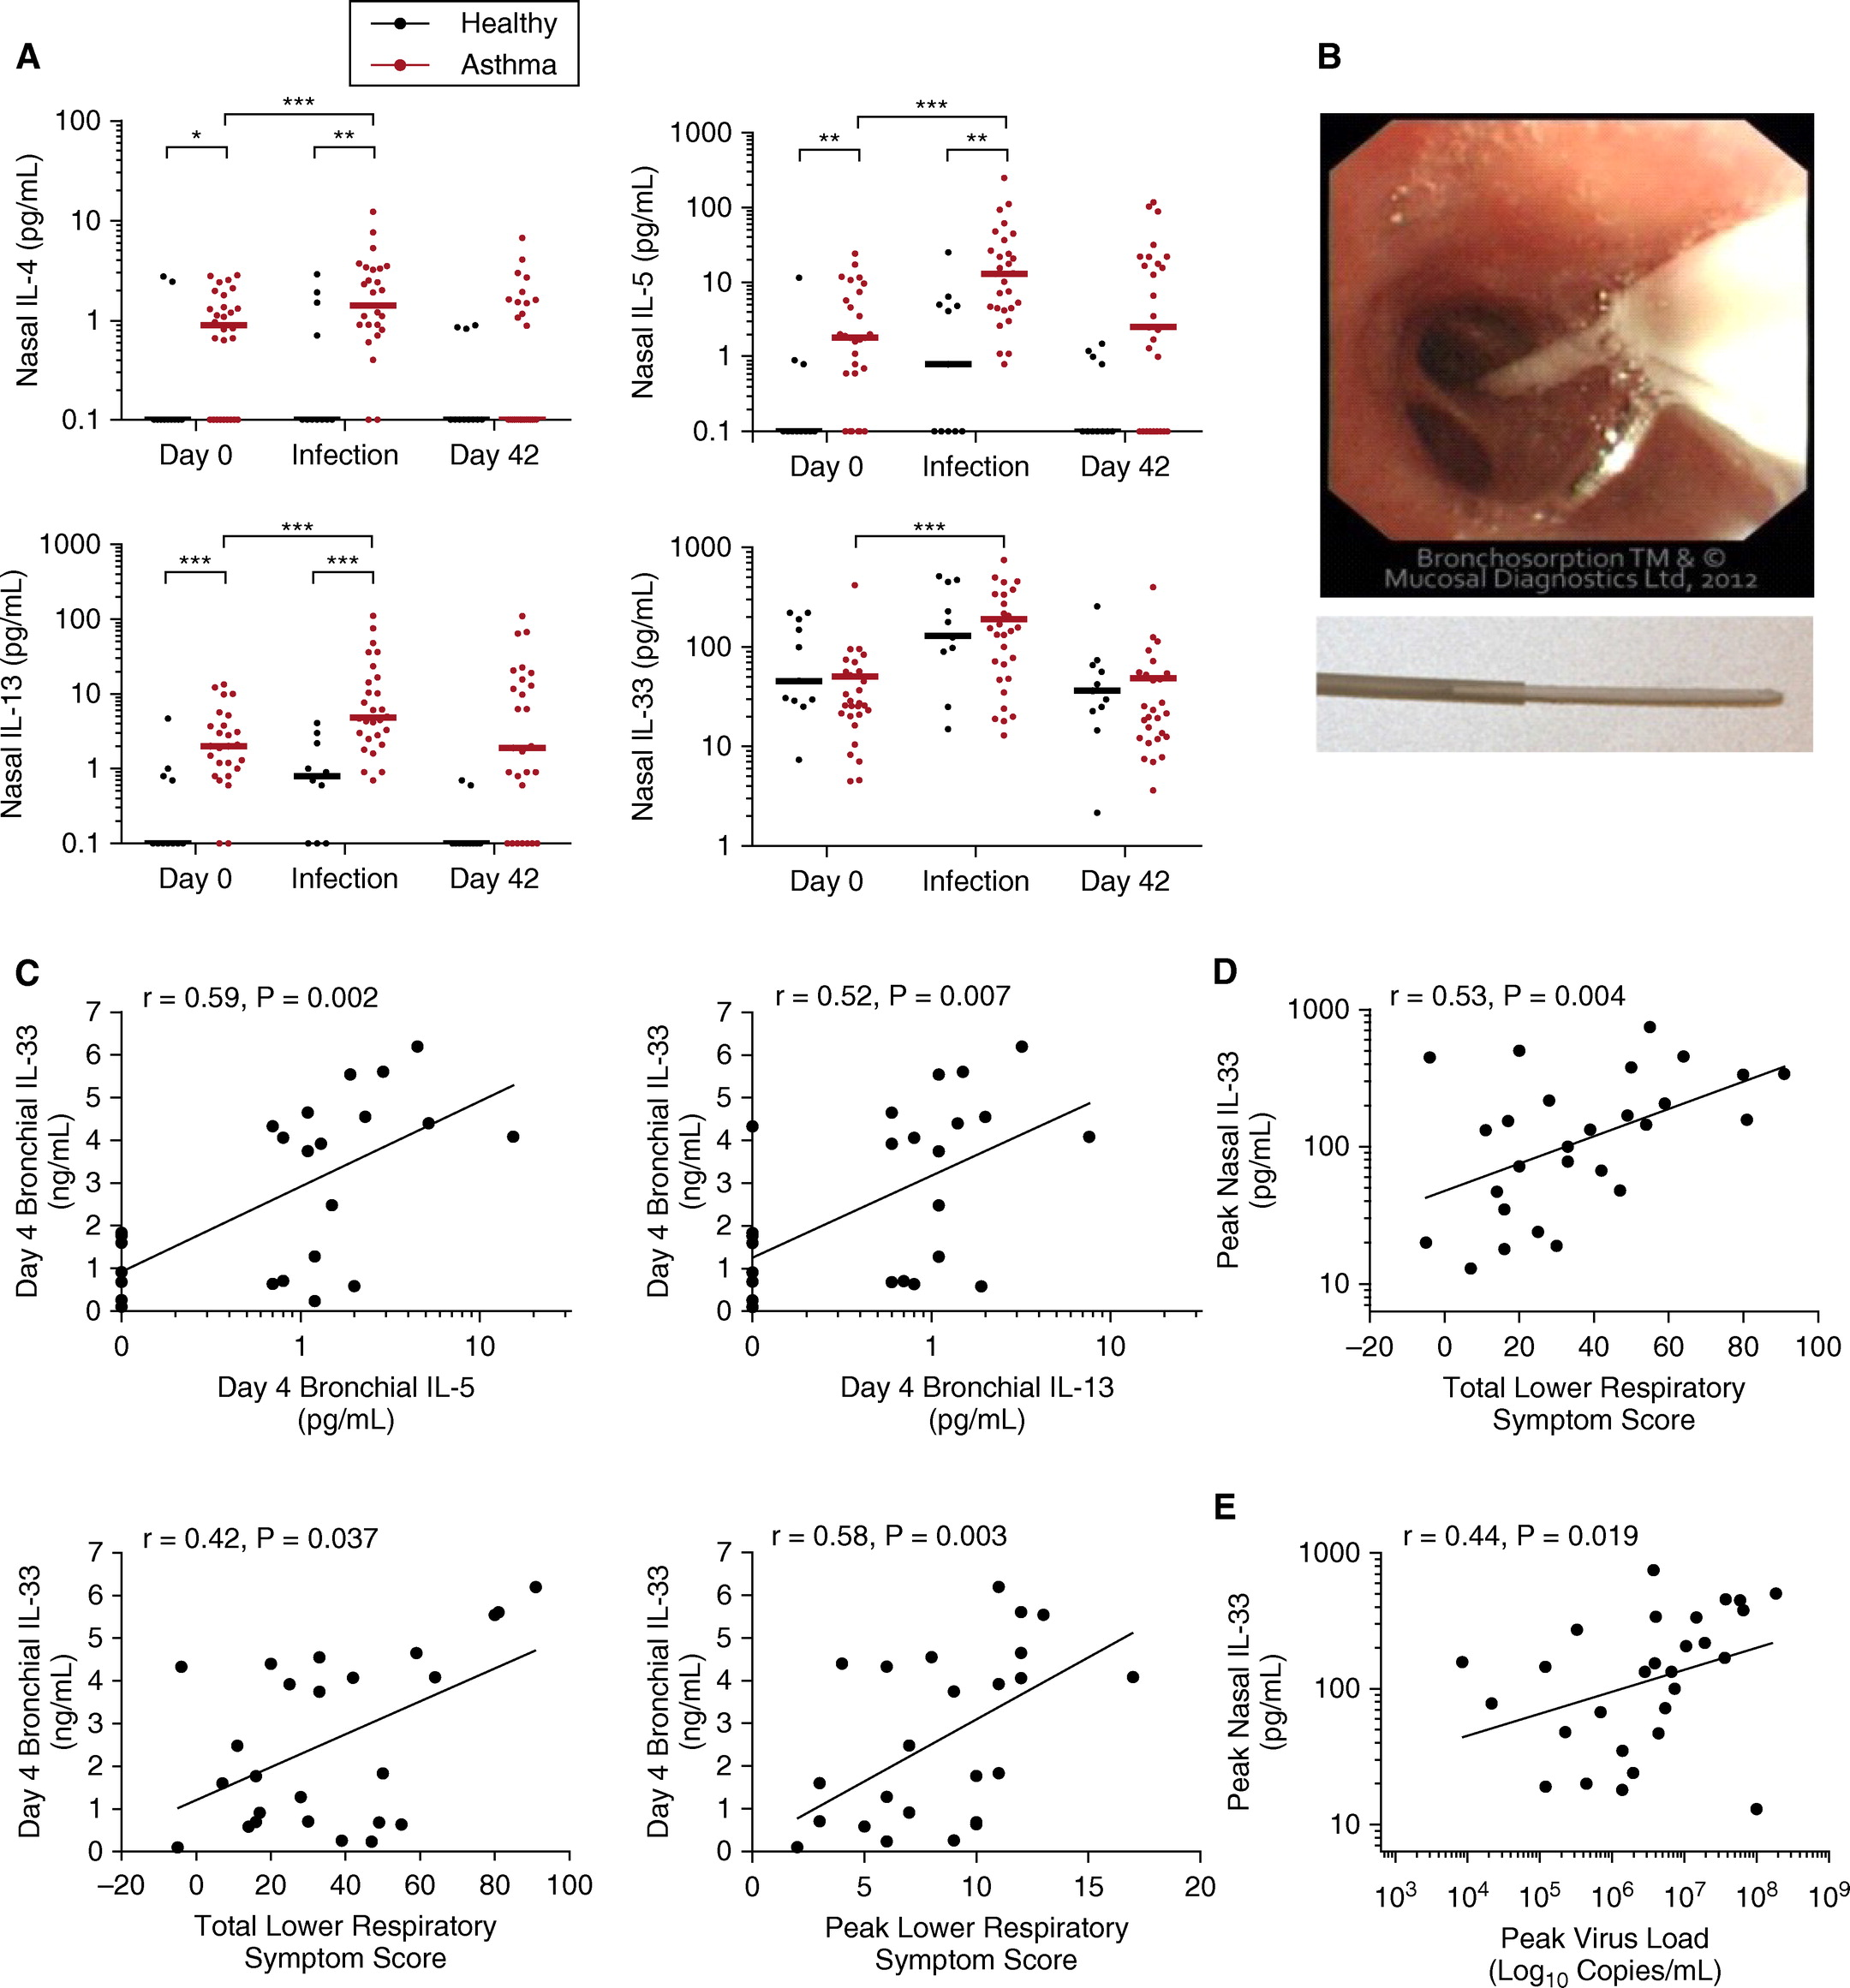
In-vivo induction of Th2 cytokines and BAL eosinophils by viral infection was only observed in people with asthma
IL-4 expression levels
IL-5 expression levels
IL-13 expression levels
Healthy
Asthma
Percentage BAL eosinophils
*P<0.05, **P<0.01, ***P<0.001
BAL, bronchoalveolar lavage; IL, interleukin; Th, T helper
Jackson DJ, et al. Am J Res Crit Care Med 2014;190:1373–1382

Slide 7
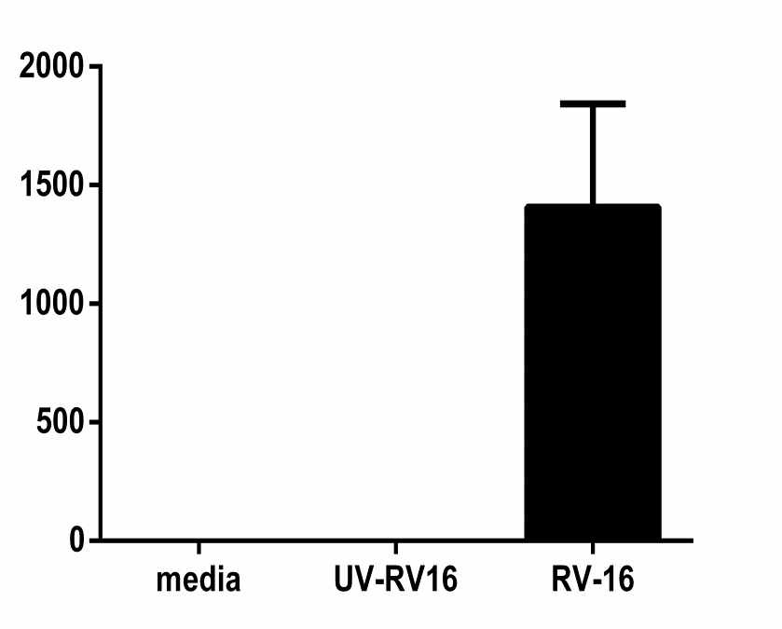
Virus-induced IL-33 correlates with Th2 cytokine induction, lower respiratory symptom severity, and virus load
Viral infection induced IL-33
IL-33 expression, symptom score and virus load
Healthy
Asthma
r = 0.59, P = 0.002
r = 0.52, P = 0.007
r = 0.53, P = 0.004
7
7
1000
6
6
5
5
4
4
Peak Nasal IL-33 (pg/mL)
Day 4 Bronchial IL-33 (ng/mL)
Day 4 Bronchial IL-33 (ng/mL)
100
3
3
2
2
1
1
10
0
0
0
1
10
0
1
10
−20
0
20
40
60
80
100
Day 4 Bronchial IL-5
(pg/mL)
Day 4 Bronchial IL-13
(pg/mL)
Total Lower Respiratory
Symptom Score
7
r = 0.42, P = 0.037
7
r = 0.58, P = 0.003
1000
r = 0.44, P = 0.019
6
6
5
5
Peak Nasal IL-33 (pg/mL)
Day 4 Bronchial IL-33 (ng/mL)
Day 4 Bronchial IL-33 (ng/mL)
4
4
100
BEC IL-33 (pg/mL)
3
3
2
2
1
1
10
0
-20
0
20
40
60
80
100
0
Total Lower Respiratory
Symptom Score
0
5
10
15
20
10³
10⁴
10⁵
10⁶
10⁷
10⁸
10⁹
Peak Lower Respiratory
Symptom Score
Peak Virus Load
(Log₁₀ Copies/mL)
*P<0.05, **P<0.01, ***P<0.001
BEC, bronchial epithelial cell; IL, interleukin; RV, rhinovirus; Th, T helper; UV, ultraviolet
Jackson DJ, et al. Am J Res Crit Care Med 2014;190:1373–1382

Slide 8
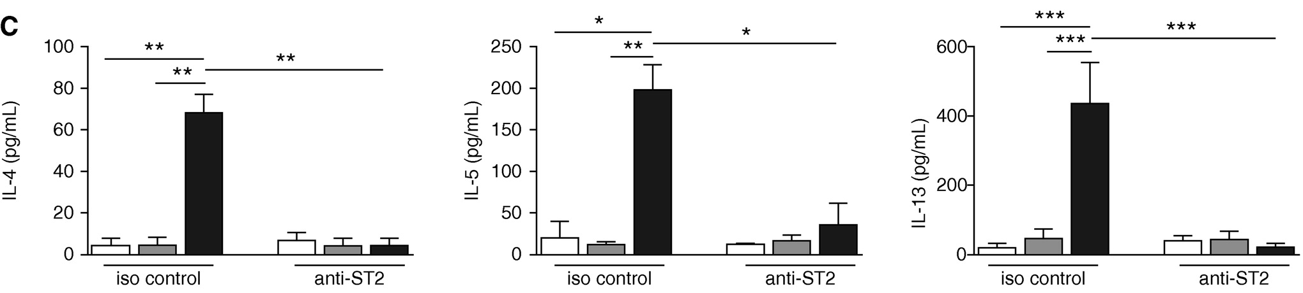
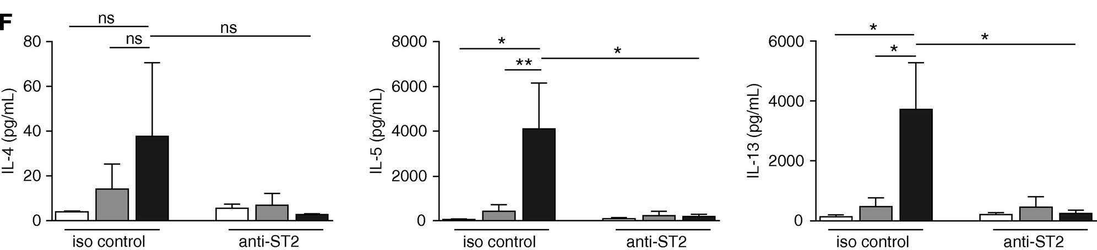
IL-33 in RV-infected BEC supernatants induces Th2 cytokine secretion in human T cells and ILC2s
Th0 cells
Th0 cells + medium
Th0 cells + supernatant from uninfected BECs
Th0 cells + supernatant from RV-infected BECs
ILC2s
ILC2s + medium
ILC2s + supernatant
from uninfected BECs
ILC2s + supernatant
from RV-infected BECs
*P<0.05, **P<0.01, ***P<0.001, data are expressed as mean ±SEM, n=6
BEC, bronchial epithelial cell; IL, interleukin; ILC2, type 2 innate lymphoid cell; iso, isotype; ns, non-significant; RV, rhinovirus; Th, T helper
Jackson DJ, et al. Am J Res Crit Care Med 2014;190:1373–1382

Slide 9
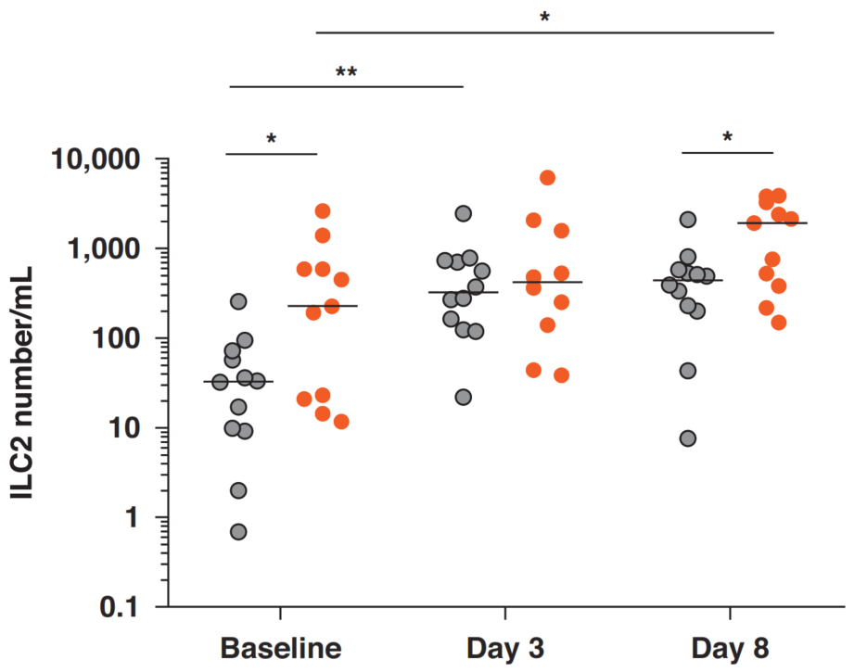
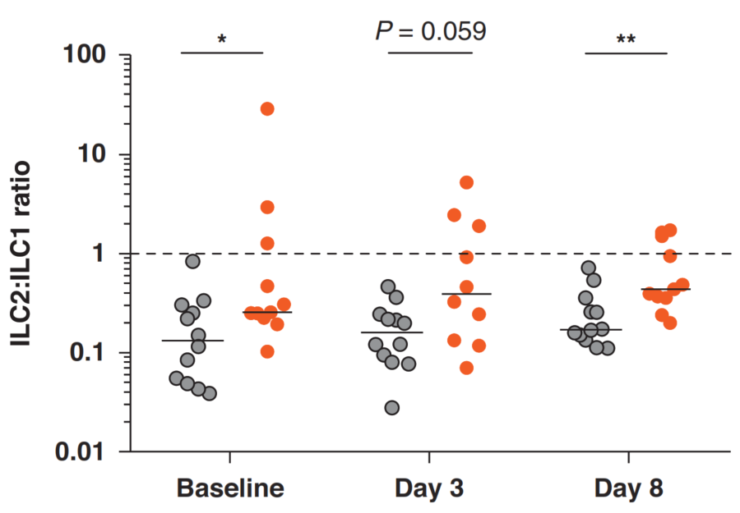
BAL ILC2s are increased in asthma and are further increased during infection
ILC2 numbers at baseline and during rhinovirus infection¹
Healthy and moderately asthmatic individuals were inoculated with RV-16 on Day 0
Bronchoscopies were performed at baseline, Day 3 and Day 8
  Nasal lavage virus load significantly increased in patients with
  asthma on Day 4
  Nasal IL-5 (P<0.001) and IL-13 (P=0.08) were induced by rhinovirus infection in patients with asthma
Pulmonary ILC1 and ILC2s were quantified in BAL using flow cytometry. The BAL ILC2:ILC1 ratio was assessed to determine their relative contribution to the clinical and immunological response to RV challenge
  ILC2:ILC1 ratios correlate with T2 cytokine induction and clinical outcomes during infection
Healthy
Asthma
* P<0.05, **P<0.01, ***P<0.001
BAL, bronchoalveolar lavage; IL, interleukin; ILC1, type 1 innate lymphoid cell; ILC2, type 2 innate lymphoid cell; RV, rhinovirus; T2, type 2
Dhariwal J, et al. Am J Respir Crit Care Med 2021;204;1259–1273

Slide 10
IL-25 and TSLP are also induced by virus infection and mediate asthma exacerbation
RV-infected asthmatic BECs had greater IL-25 expression compared with non-asthmatic BECs¹
Greater induction of nasal IL-25 by experimental RV infection was observed in subjects with asthma¹
In mice, RV infection induced IL-25 expression and augmented allergen-induced IL-25¹
TSLP is induced in BECs by viral infection mimic poly(I:C),² and in BECs and BALF by RV infection³
BALF, bronchoalveolar lavage fluid; BEC, bronchial epithelial cell; IL, interleukin; poly(I:C), Polyinosinic:polycytidylic acid; RV, rhinovirus; TSLP, thymic stromal lymphopoietin
1. Beale J, et al. Sci Transl Med 2014;6:256ra134; 2. Cerps S, et al. Allergy 2022;77:2498–2508; 3. Mehta AK, et al. J Allergy Clin Immunol 2016;137:278–288

Slide 11
Host resistance and tolerance depend on disease severity
IFN-β expression in BECs*
IL-33 expression in BECs*
TSLP expression in BECs*
6000
P=0.1079
10
P=0.0014
1000
P=0.2109
P=0.0056
P=0.5935
P=0.0050
P=0.8421
P=0.0183
8
100
4000
IFN-β mRNA expression (poly (I:C) fold-change relative to control)
6
IL-33 expression (poly (I:C)
fold-change relative to control
TSLP expression (poly (I:C)
fold-change relative to control
10
4
2000
2
1
0
0
0.1
Untreated
Moderate
Severe
Mild
Moderate
Severe
Mild
Moderate
Severe
*Overall population (N=50): mild/untreated (n=20), moderate (n=16), severe (n=14)
BEC, bronchial epithelial cell; IFN-β, interferon beta; IL-33, interleukin 33; mRNA, messenger ribonucleic acid; poly(I:C), polyinosinic:polycytidylic acid; TSLP, thymic stromal lymphopoietin
Porsbjerg C, et al. Eur Respir J 2022;60:2102333

Slide 12
Summary
Impaired innate antiviral responses in BECs in asthma increase the risk of exacerbation^{1,2}
Respiratory virus infections impact the host airway epithelium by increasing barrier permeability,^{3,4} impairing host resistance^{5,1} and dysregulating host tolerance^{6,7}
Asthma phenotype and severity influence the bronchial epithelial immune response to stimulation by viral mimics⁷
IL-33, TSLP and IL-25 are induced by viral infection and mediate asthma exacerbations^{8,9}
IFN-β, interferon beta; T2, type 2; TSLP, thymic stromal lymphopoietin
1. Wark PA, et al. J Exp Med 2005;201:937–947; 2. Feddema JJ, Claassen E. Respir Med 2020;173:106020; 3. Looi K, et al. Exp Lung Res 2016;42:380–395; 4. Saatian B, et al. Tissue Barriers 2013;1:e24333; 5. Contoli M, et al. Nat Med 2006;12:1023–1026; 6. Uller L, et al. Thorax 2010;65:626–632; 7. Porsbjerg C, et al. Eur Respir J 2022;60:2102333; 8. Jackson DJ, et al. Am J Res Crit Care Med 2014;190:1373–1382; 9. Mehta AK, et al. J Allergy Clin Immunol 2016;137:278–288

